Slide 1

Presented by Sanket Magarkar
Guide: Prof U A Athavankar
PRODUCT DESIGN CHECK LIST

Slide 2
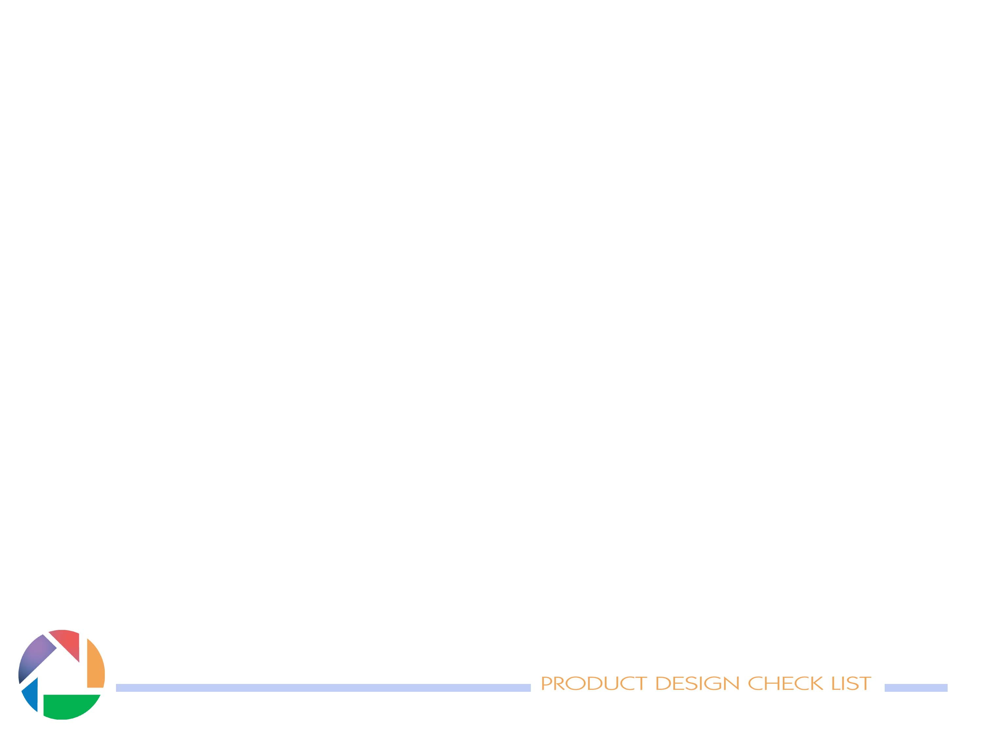
Brief
A tool based on the techniques of Structured Planning in design.
Development of the work done by the Prof U A Athavankar and Prof Charles L. Owen .
Earlier project done by Phull Rajinder Singh
Structured planning is an extensive and rigorous method of developing a design plan.

Slide 3
Structured planning
Developed and taught at the Institute of Design by Research Professor Charles L. Owen .
Ability to tackle large scale design problems and use of custom computer program
Implemented as a series of documents, each an empty form to be completed by the designer.
This design factor form requires brainstorming of insights taken directly from observation and links these insights explicitly to named concepts.

Slide 4
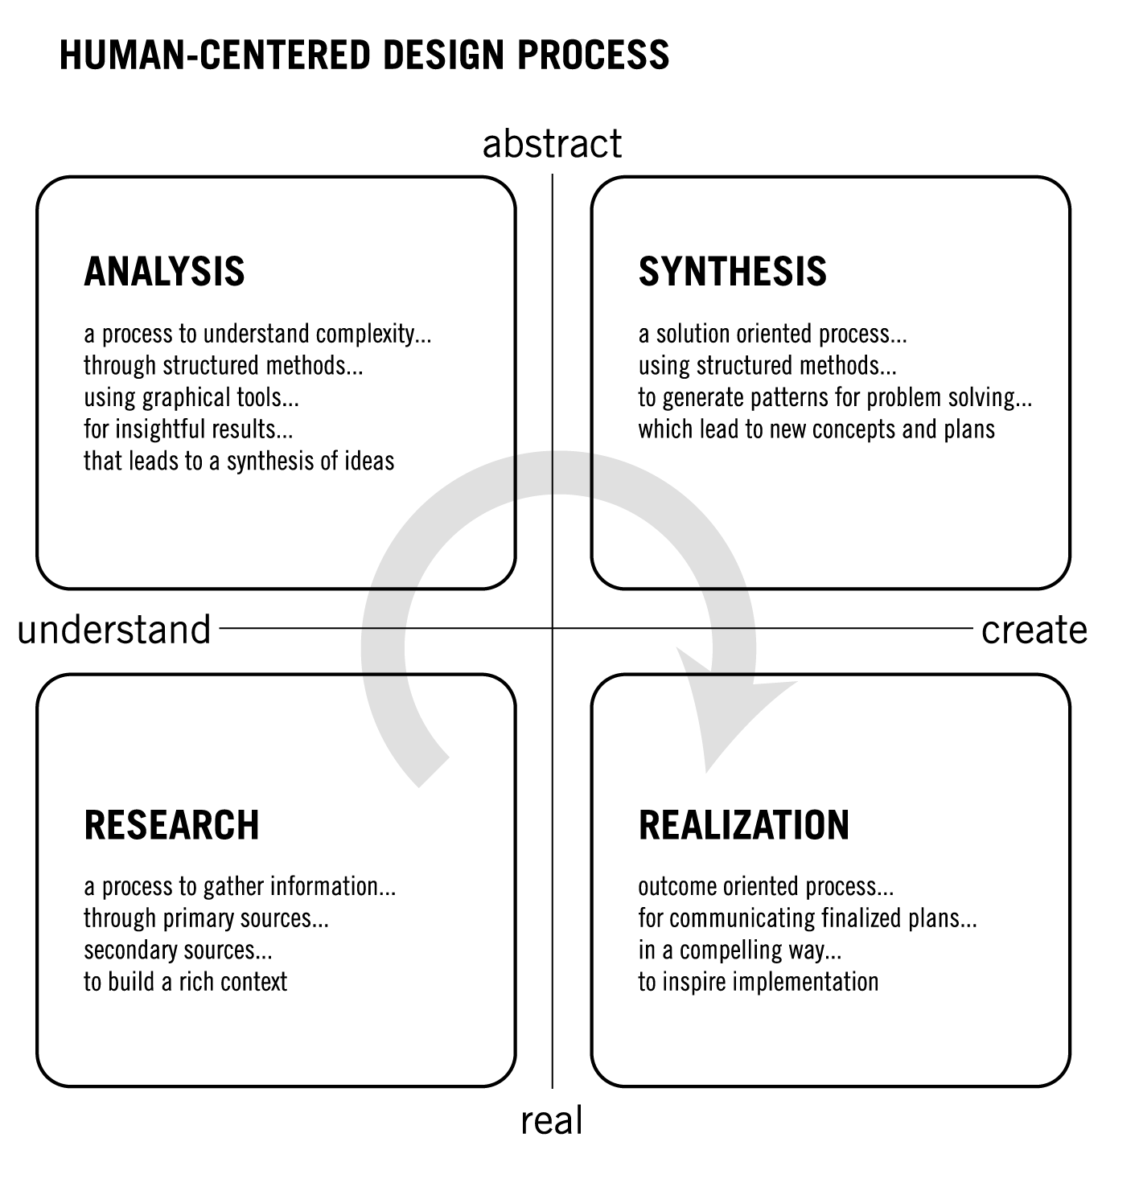

Slide 5
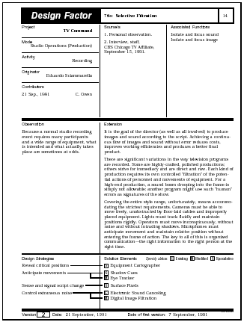
The Design Factor form thus documents the human-centered motivation for concepts in a holistic manner.

Slide 6
Need for check list
The ’Design Check List’ - exhaustive sets of questions
-encouraging the designer to get into systematic thinking
mode provide an multidimensional view towards the problem.

Slide 7
Goals
Putting the designer in a analytical thinking mode in the initial design phases.
        Encouragement
        Customization
        Organization
        Documenting
        Sharing
-With a dynamic software platform

Slide 8
Methodology
level 1
Enriching databases for different aspect of the design.
use of analytical questions in collection of the data
exploring use of tools like
activity analysis diagram
flow charts
logic lines
Deciding right platform and the usability issues of the tool
working environment for multiple projects
adding/ modifying/documenting information

Slide 9
Methodology
level 2
  Providing aid for customization of databases as per user , product and user experience.
  Question reframing so as to suit the context. Use of previous user experience.
  Exploring use of creative tools
      random word technique
      Synectics
      Affinity diagramming

Slide 10
Methodology
level 3
Providing interactive platform for conversational, motivational and speech abilities.
Use of logic of ‘eliza’ to build up a conversation pattern inducing challenging environment.
Testing and modifying tool with the help of initial time span of P3.

Slide 11
exce
The platform tested….
Axon2005
The Idea behind the Axon Idea Processor is to provide an environment that supports thinking.
Axon's design is based upon the Cognitive Sciences, which attempts to unify views of thought developed by studies in Psychology, Linguistics, Anthropology, Philosophy, Computer Science, and Neuro Science.
Microsoft excel

Slide 12
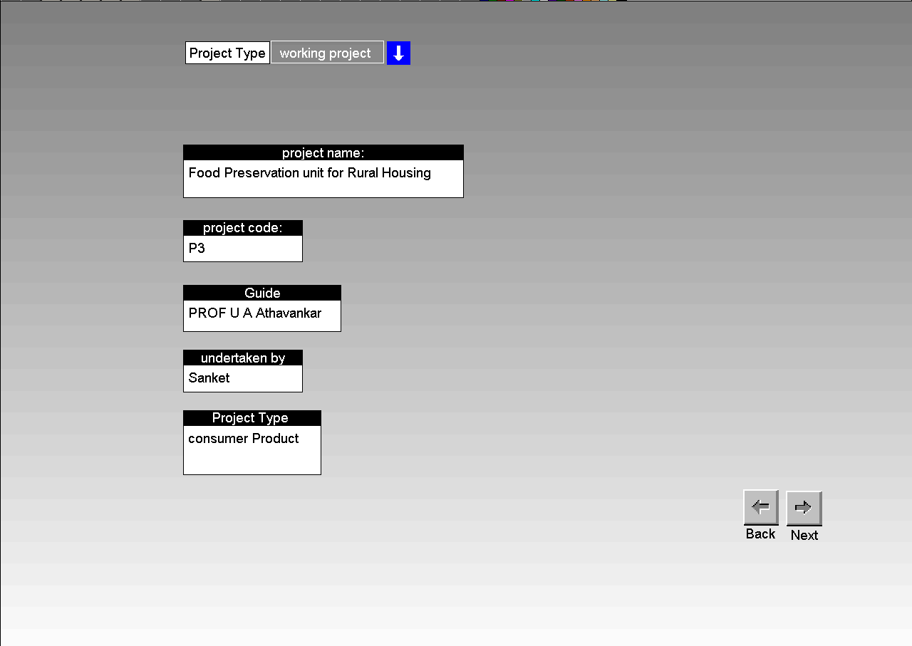
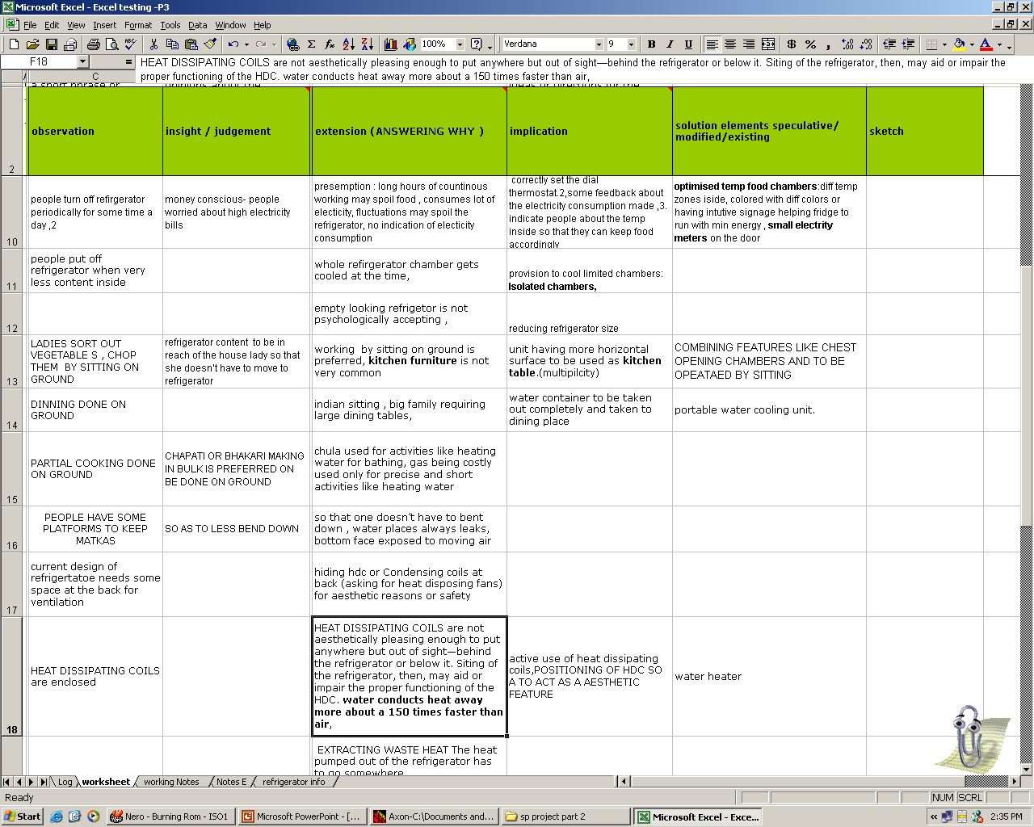
Axon2005
Microsoft excel

Slide 13
Thank you..

